Slide 1


Welcome to the ifmaKC September
Programs Meeting

Slide 2
Women In Construction
Presented & Moderated by
Janelle Agnos & Cheyenne Farmer

Slide 3

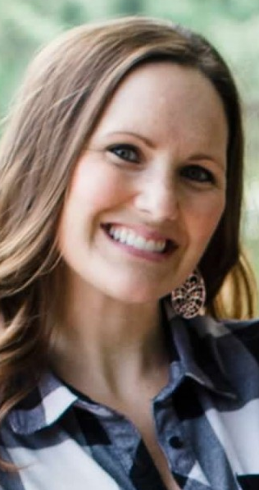
Moderator: Janelle Agnos: Branch Chief, General Services Administration
Janelle Agnos leads regional facilities programs for 7 service centers throughout the Midwest. During her career with GSA , beginning as an intern in 2006, Janelle has served as a Building Manager, then as a Deputy Director of the Kansas City South Service Center where she was responsible for oversight of over 3M sf of federal space and 3M sf of leased space in the State of Missouri.
Janelle earned a Bachelor's Degree in Applied Management from National American University. She currently holds a Facility Management Professional (FMP) designation from IFMA and both the Real Property Administrator (RPA) and the Facilities Management Administrator (FMA) designations from BOMA.

Slide 4

Moderator: Cheyenne Farmer: Client Success Partner, SHC Roofing
Cheyenne moved to Springfield, Missouri to go to college at Missouri State University in 2016. Her emphasis was on sales and marketing. Cheyenne’s experience includes hospitality, insurance, and marketing. After 4 years in Springfield, she moved to Johnson County & started as the Client Success Partner for SHC Roofing.
Cheyenne was 1st runner up Miss Topeka. Cheyenne is the Student Liaison for IFMA KC. She hopes to bring more women, youth, & diversity into the facilities and trade industries.
For fun, she loves traveling, going home to NWA to see family, and farmer’s markets on Saturday mornings.

Slide 5
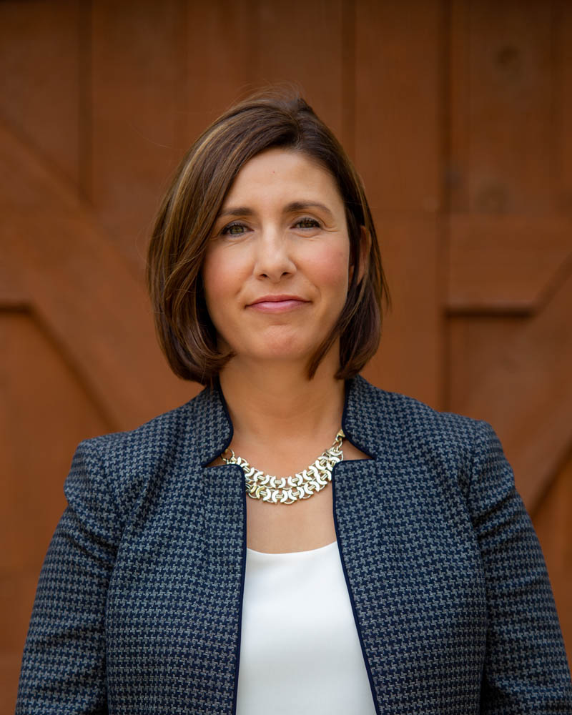
Panelist: Mandi Hunter: Founder, Hunter Law Group
With over 20 years of legal practice, and a willingness to go above and beyond, Mandi’s career has resulted in significant clarifications and changes to the laws pertaining to certain real estate issues on both sides of the state line.
A native of the Kansas City area, Mandi is admitted to practice law in both Kansas and Missouri. She received her Bachelor of Arts in Political Science from the University of Kansas and graduated with honors. She then went on to obtain her law degree from the University of Missouri-Columbia. She is honored to be recognized as a “Super Lawyer – Top 50 Women” in Missouri and Kansas as well as being recognized by the Best Lawyers in America.
When she is not practicing law, Mandi enjoys giving back to the Kansas City Community by serving as a member of several legal associations and as a director on a variety of boards and commissions, including the Johnson County Bar Association Board of Directors, and being appointed to the Leawood Planning Commission.

Slide 6
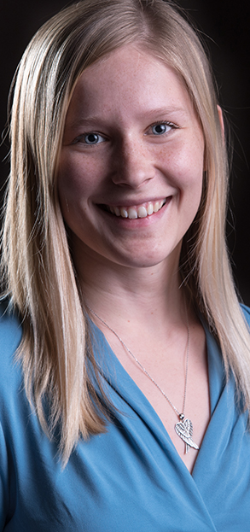
Panelist: Haley Jones: Project Manager, A.L. Huber General Contractor
Haley is a valuable member of the A.L. Huber project management team, responsible for the success of projects starting with her involvement during preconstruction through completion. She understands the value of partnering with her clients, members of the design team and subcontractors to not only deliver the project as promised, but to make the process a collaborative and fun experience. Haley has managed some of the A.L. Huber’s most recent successful projects for MidAmerica Nazarene University, Kansas City Art Institute and Autism from the Start.
Haley is a proud alumni of University of Central Missouri’s Construction Management Bachelor of Science program. She is also a graduate of the AIA Kansas City Pillars program and is involved in many industry organizations including Design Build Institute of America (DBIA) NextGen and Commercial Real Estate Women Kansas City Chapter (CREW KC) Mentorship Program.

Slide 7
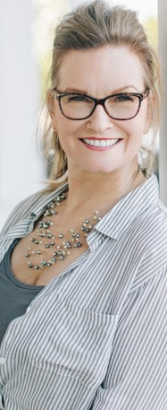
Panelist: Sheryl Vickers, CCIM: Owner, Select Sites, LLC
Select Sites, LLC, is a woman owned commercial real estate firm in Kansas City, sells or leases approximately Five Million in transaction value per year. Top clients include Rack Room Shoes, Barnes & Noble, Barrio Brookside, Primrose Schools, Family Dollar and many local companies. Sheryl has been licensed in both Kansas and Missouri for more than 25 years, and has earned her CCIM designation in 2005, which recognizes designees as the global leading experts in commercial investment real estate.
Finding ways to diversify the commercial real estate industry is a passion of hers, so she co-founded Women in Real Estate Development (WIRED) in 2017 with Audrey Navarro. WIRED is a women's mentoring and support group that acts as a portal into commercial brokerage, development and investment opportunities in Kansas City. In 2018, she was selected to be a Real Estate Associates Program (REAP) Instructor. REAP was replaced in 2019 by the ULI REDI program and volunteered as one of a handful ULI Mentors as well as serving on the REDI planning committee for two years. Sheryl was honored to be chosen as a Capstone Awards Judge for 2020.
​AWARDS RECEIVED: Power Broker in Retail Award (Leasing CoStar Group) (2012, 2013, 2014, 2017); KC Top Connector (Ewing Marion Kauffman Foundation); Kansas City Influential Women Award honoree (Kansas City Business Magazine) and selected as a 2019 Enterprising Woman of the Year honoree by Enterprising Women Magazine.

